Slide 1
Contrasting patterns of population structure and connectivity across northern Australia in a commercially important fish Lutjanus johnii
Integrating population genetics, genomics and ecological markers
Laura Taillebois, Diane Barton, David Crook, Danielle Davenport, Thor Saunders, Jennifer Ovenden
2-6 October 2017, Papeete

Slide 2
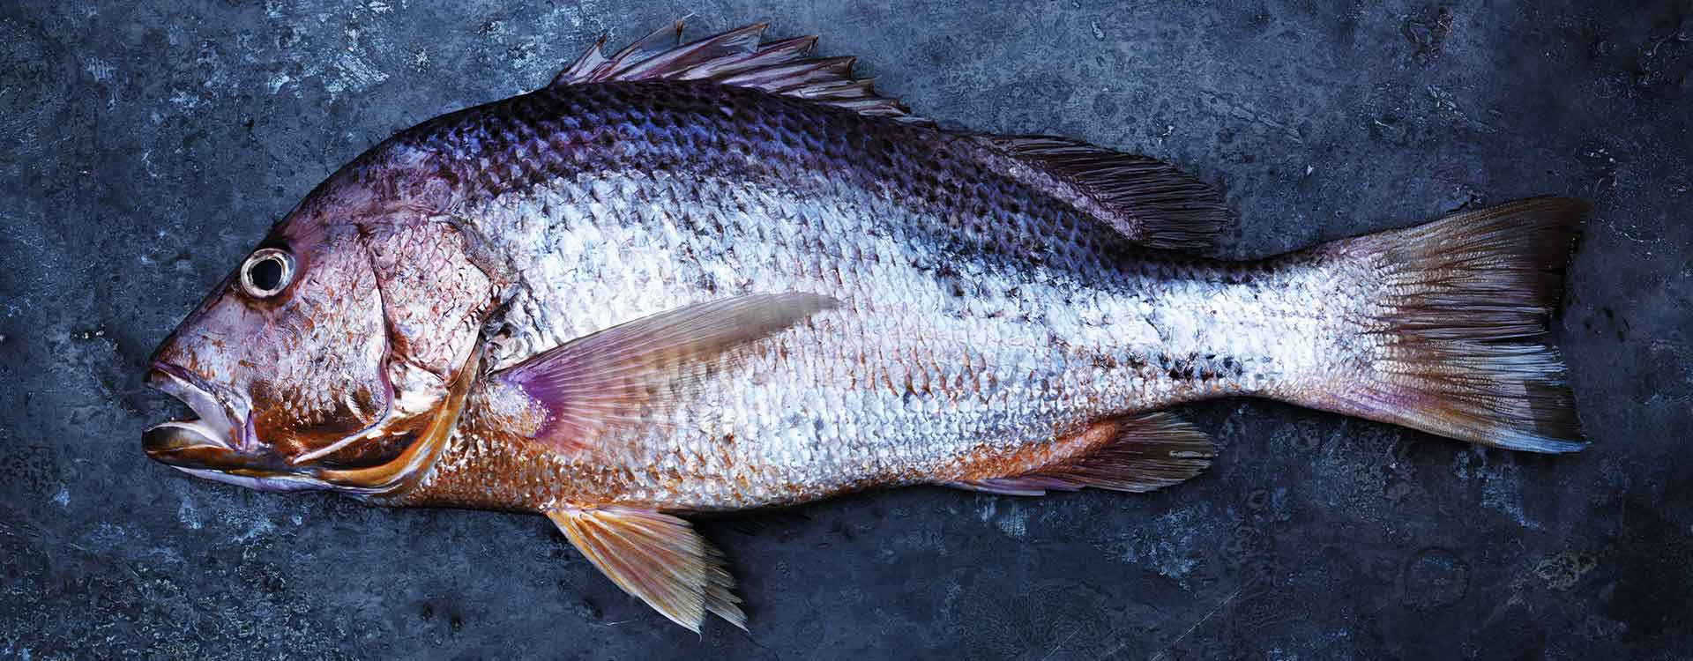
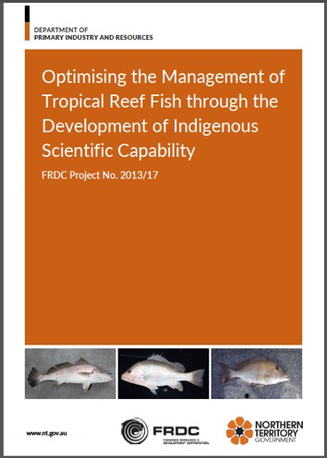
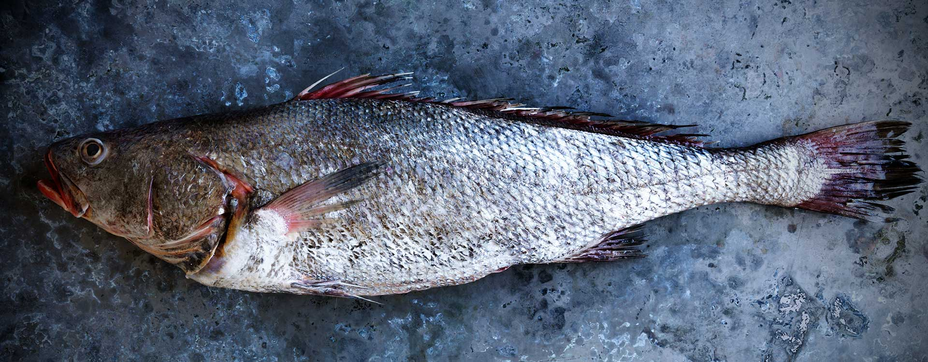
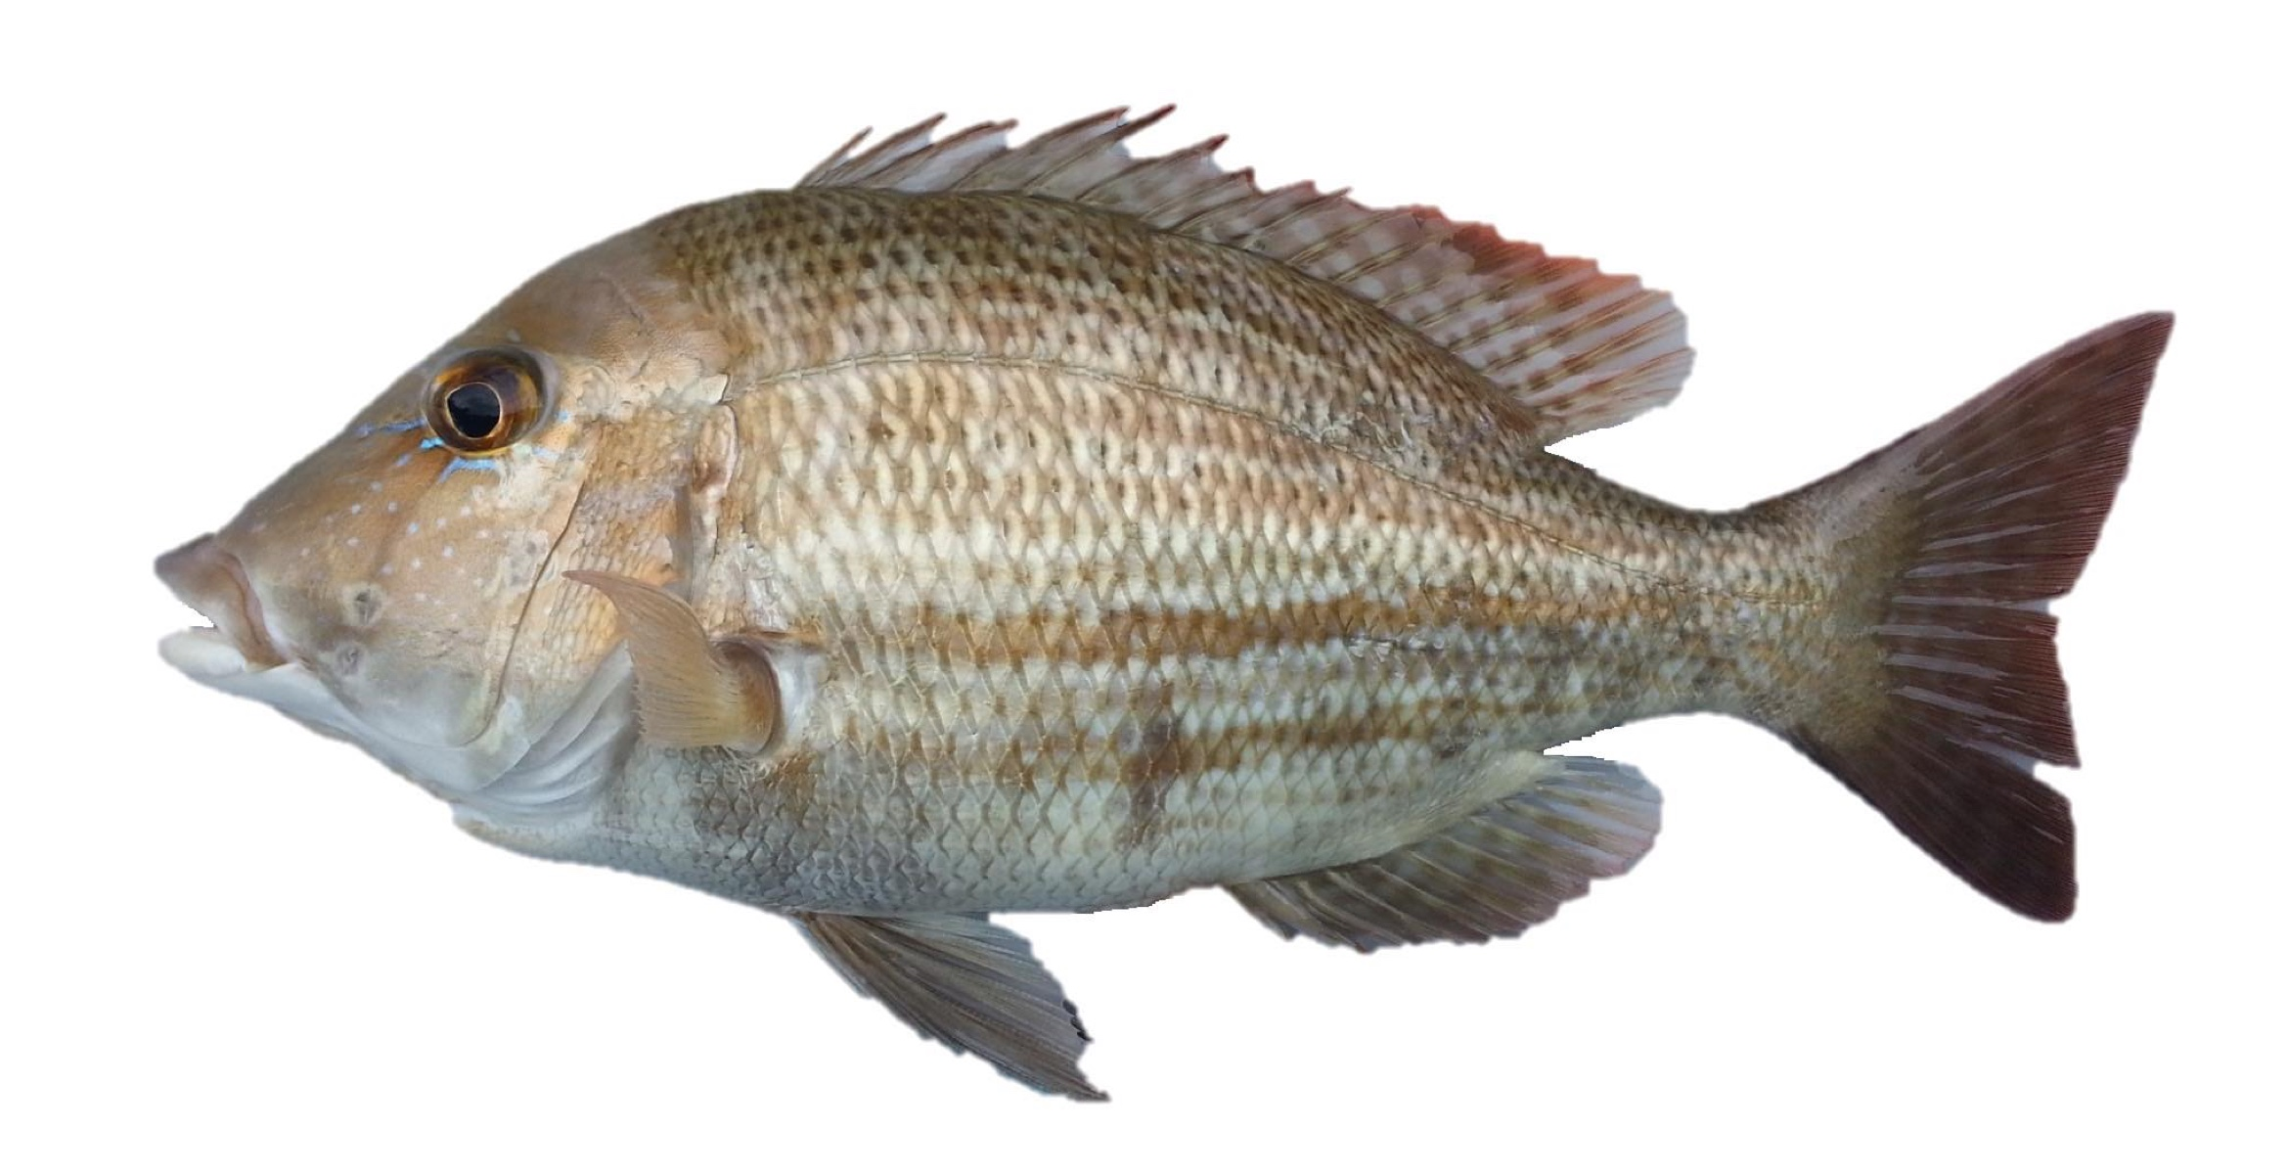
Background & Motivation
A Fisheries Research and Development Corporation project was initiated after the observation of recent declines in fish species across northern Australia due to the commercial and recreational sectors’ growth in the recent years.
Lack of knowledge on the stock structure of those species which is critical for stock assessment and to achieve sustainable exploitation.
The objectives of the project were:
Gain information on the stock structure of key tropical reef species
Identify the appropriate spatial scale for management
Lutjanus johnii, golden snapper
Protonibea diacanthus, black-spotted croaker
Lethrinus laticaudis, grass emperor
2-6 October 2017, Papeete

Slide 3
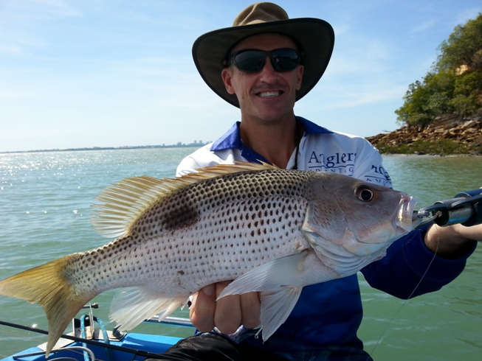

Species & Question
Distribution & Exploitation
Golden snapper (Lutjanus johnii) is widely distributed across the Indo-Pacific tropics
It is a very popular recreational & commercial fish
Localised depletions have been observed in the Northern Territory around the Darwin region
Biology & Life Cycle
Slow growing (maturity around 6-8 years), long lived (up to 28 years)
Coastal, estuaries/mangroves nurseries, adults offshore on reefs, spawning offshore ?
What is golden snapper population structure and connectivity across northern Australia?
Co-distributed species of similar biology exhibit population structure across the region
2-6 October 2017, Papeete

Slide 4
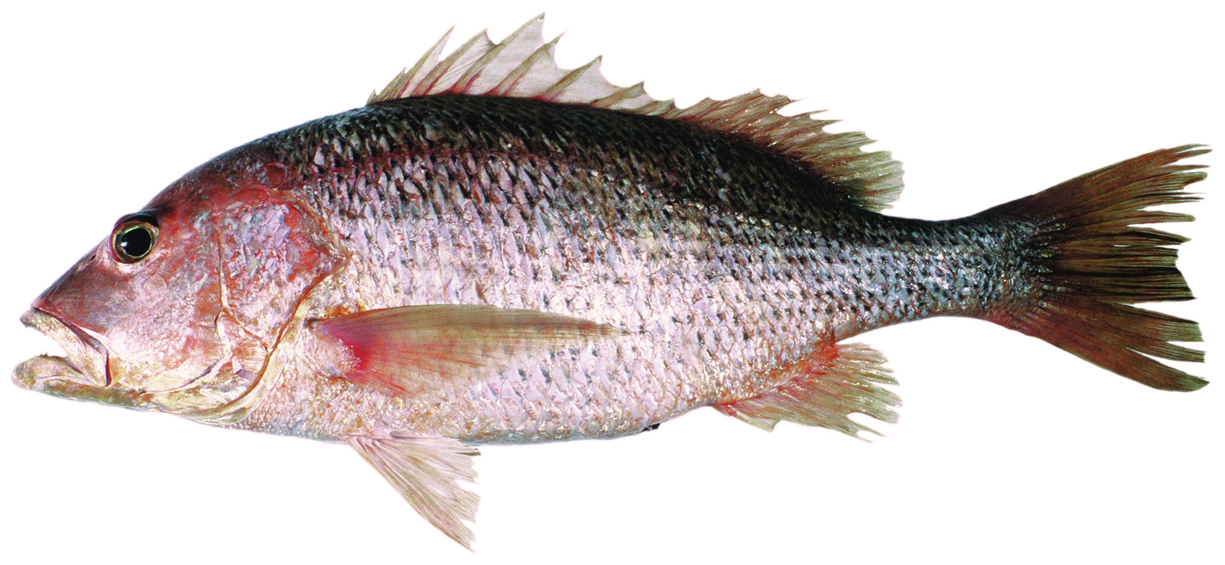
Molecular methods for broad scale population structure
Sampling
587 samples from Camden Sounds, WA → Halifax Bay, QLD (20 locations / +3,000 km)
Microsatellite markers
De novo development; NGS approach
10 microsat loci; 444 individuals; 18 locations
Genomics
188 individuals; 16 locations
Reduced complexity genome representations following DArTseqTM protocol
1,898 SNP loci suitable for population genetics
Analyses
Tested for genetic subdivision / breaks
Genetic differentiation and IBD across northern Australia
2-6 October 2017, Papeete

Slide 5
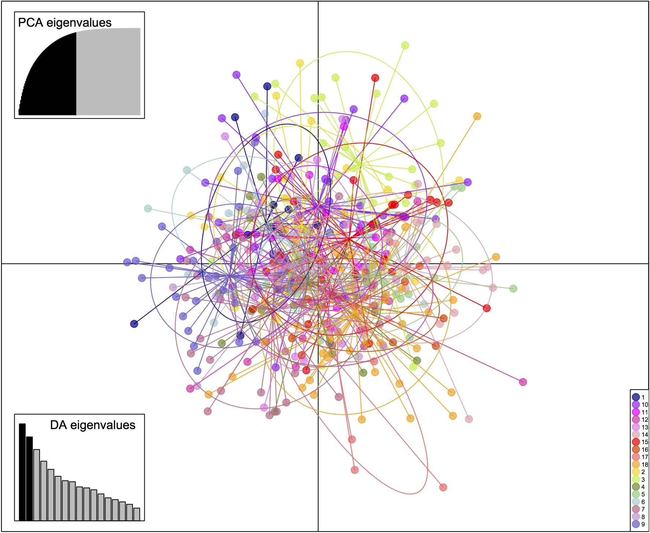
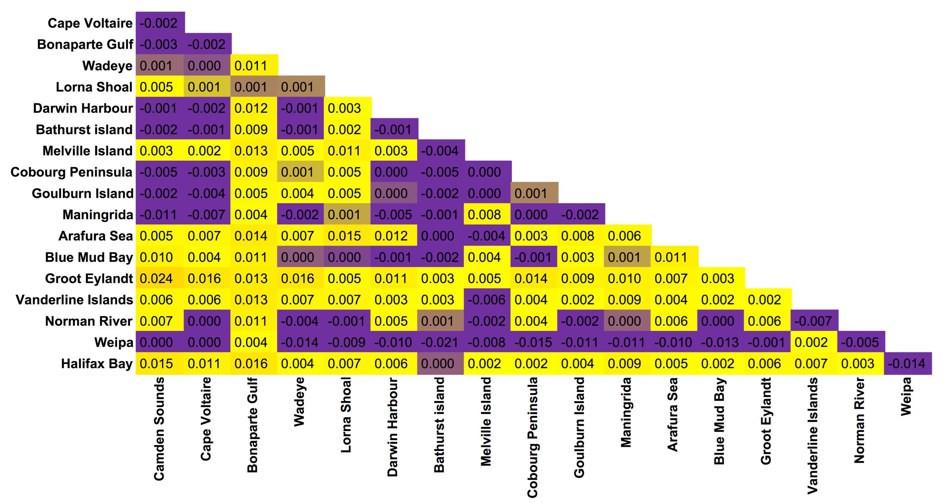
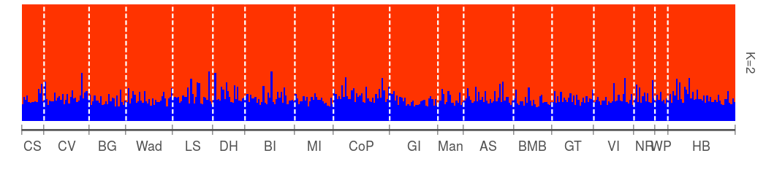
Broad scale population structure using microsatellite markers
No evidence of genetically distinct populations across northern Australia
Several species (with similar biology) reveal geographic barriers to dispersal (Lethrinus laticaudis, Protonibea diacanthus, Lutjanus carponotatus, threadfin species etc…)
Major geographic break (Torres Strait), habitat discontinuity (Kimberley vs Northern Territory), currents (Holloway Current, Arnhem Current)?
DAPC 10 microsats
444 Ind. 18 Loc.
Low pairwise F_{ST} (0 – 0.024) , no evidence of IBD
More markers?
Increase statistical power to reject panmixia?
2-6 October 2017, Papeete

Slide 6
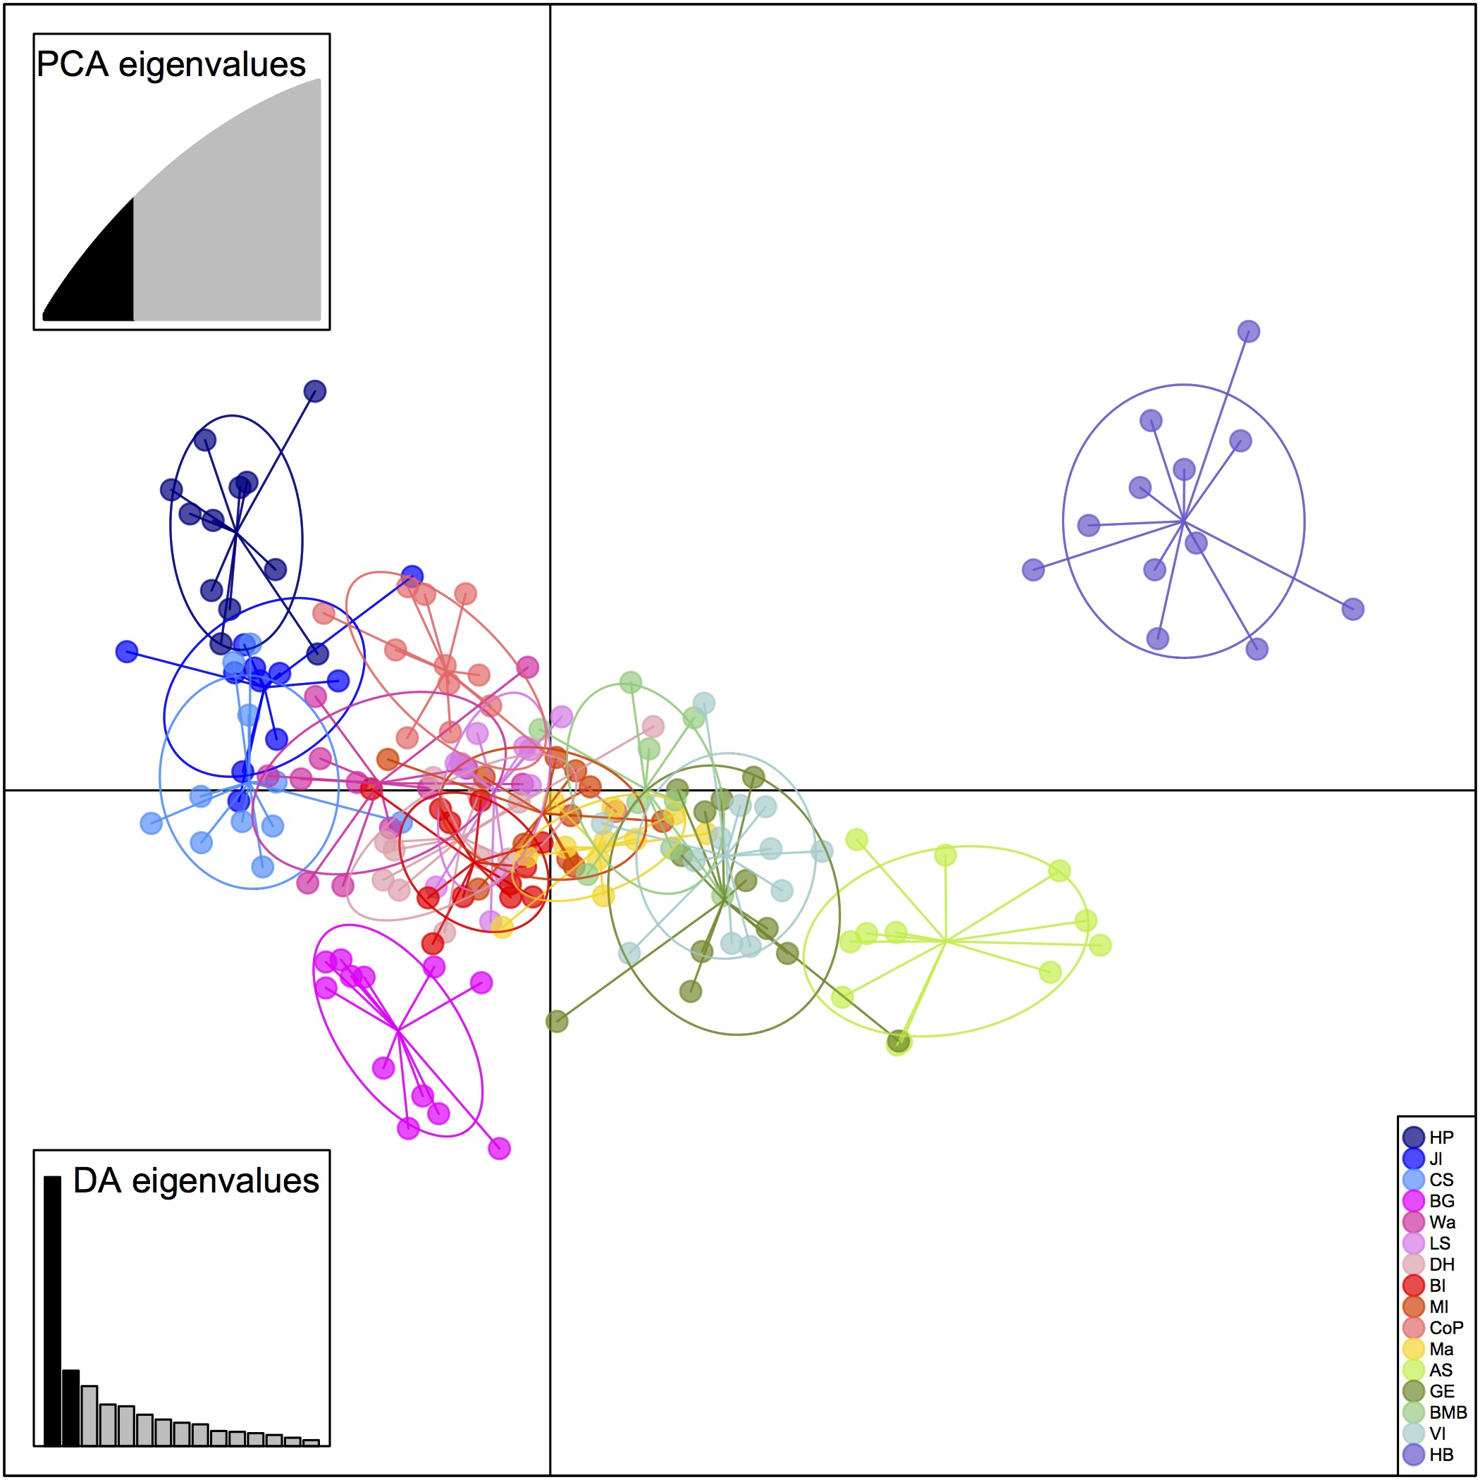
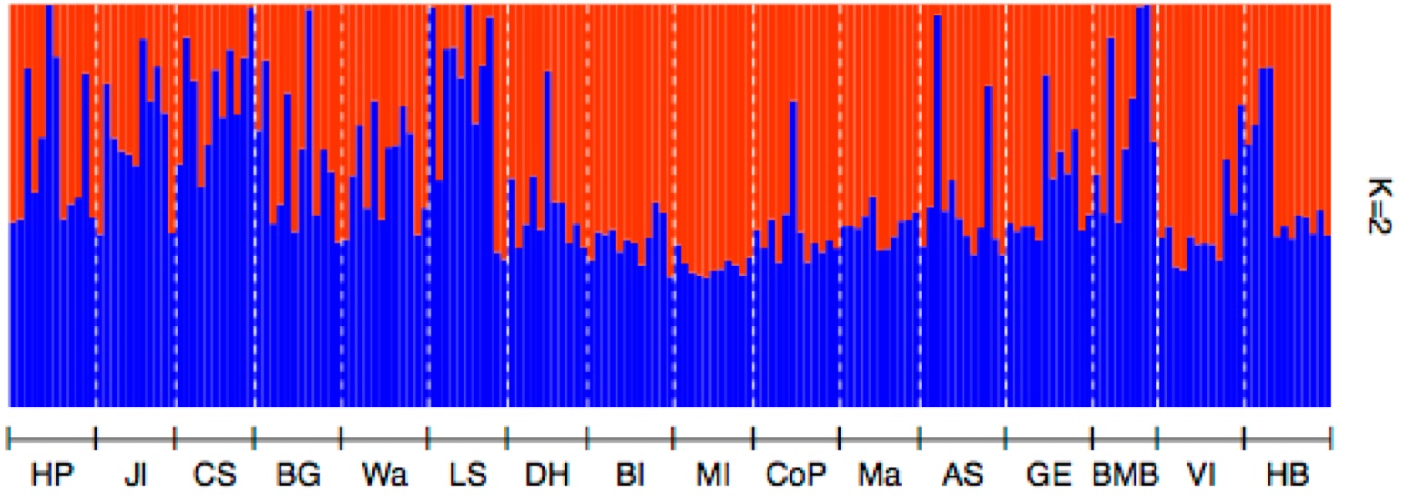
Broad scale population structure using SNP markers
DAPC 1,898 SNPs
188 Ind. 16 Loc.
Semi-structure across the Kimberley, Northern Territory and Gulf of Carpentaria
Halifax Bay
Bonaparte Gulf distinct form Kimberley and Northern Territory regions
Northern Territory
Arafura Sea (offshore population) distinct from other coastal nearby locations
Gulf of Carpentaria
Halifax Bay genetically separated from all other locations across the Torres Strait
Kimberley
Arafura Sea
Bonaparte Gulf
Structure did not reveal those groups
2-6 October 2017, Papeete

Slide 7
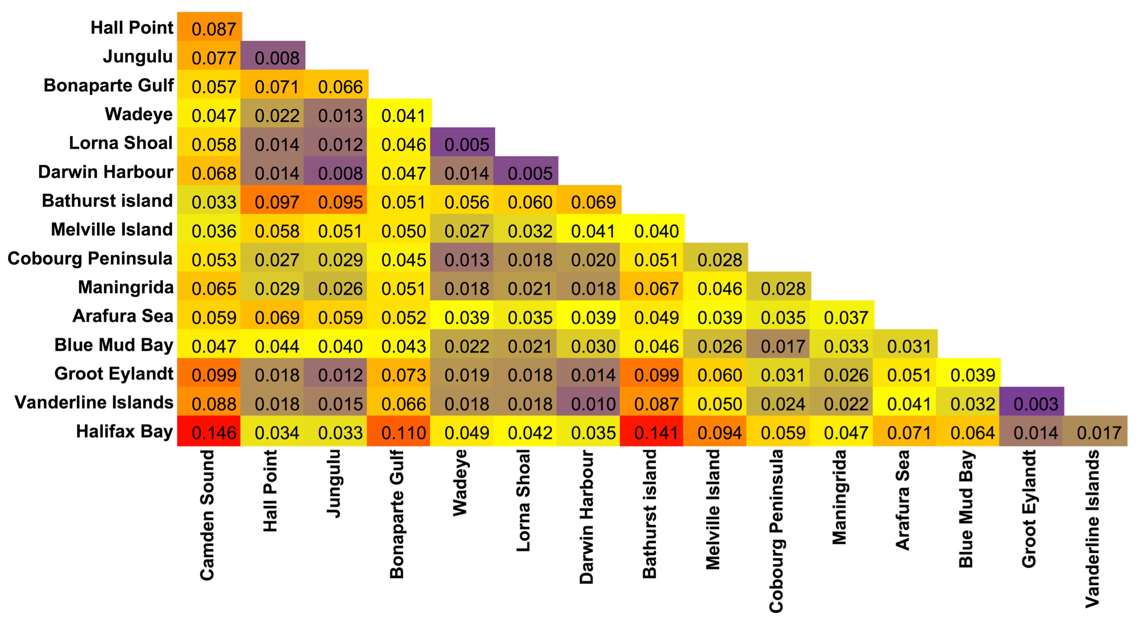
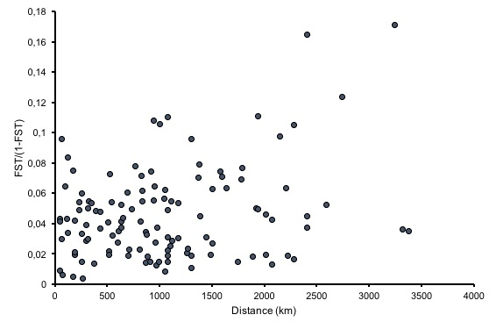
Broad scale population structure using SNP markers
r = 0.16
p-value = 0.2269
Much higher pairwise F_{ST} values than with microsatellites (0.003 – 0.146)
All significant (after Narum FDR correction)
Mantel’s correlation r low (0.16), not significant
Distance does not seem to be the best predictor in genetic differentiation
2-6 October 2017, Papeete

Slide 8
Local adaptation at the regional scale ?
Despite panmixia or weak population structure using neutral markers, golden snapper may reveal regional population structure and signatures of local adaptation to different habitats at smaller scale
Explored local adaptation at the regional scale in the Kimberley – Bonaparte Gulf region
Otolith elemental chemistry are markers of the fish environment / habitat
Parasites load (abundance) reflects the occurrence of parasites in the habitat as well as the physiological response of the fish to parasites
100 km
2-6 October 2017, Papeete

Slide 9
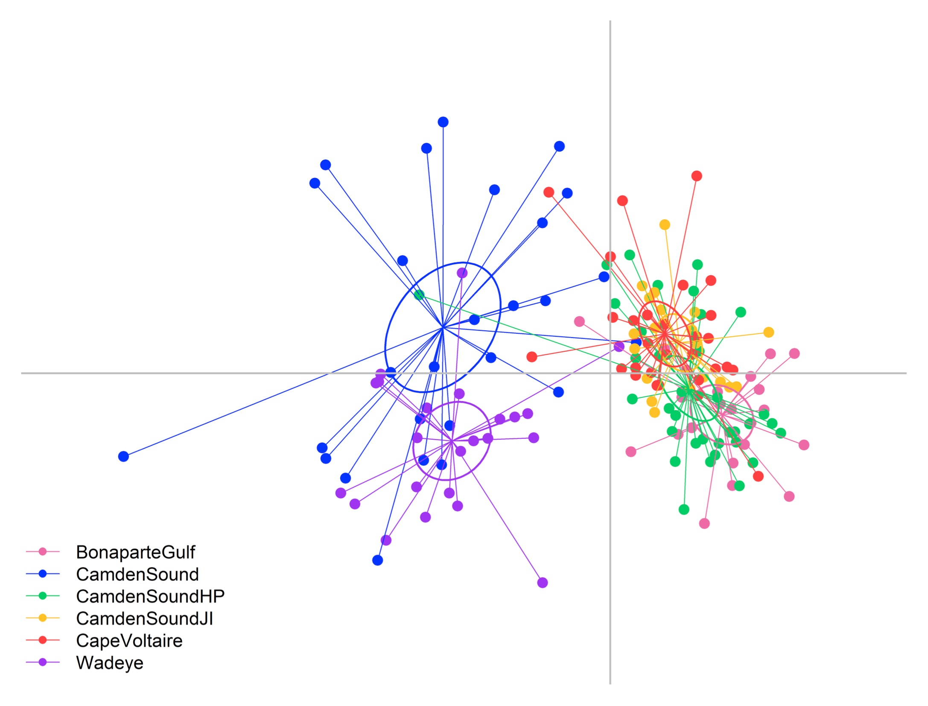
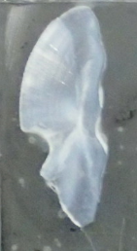
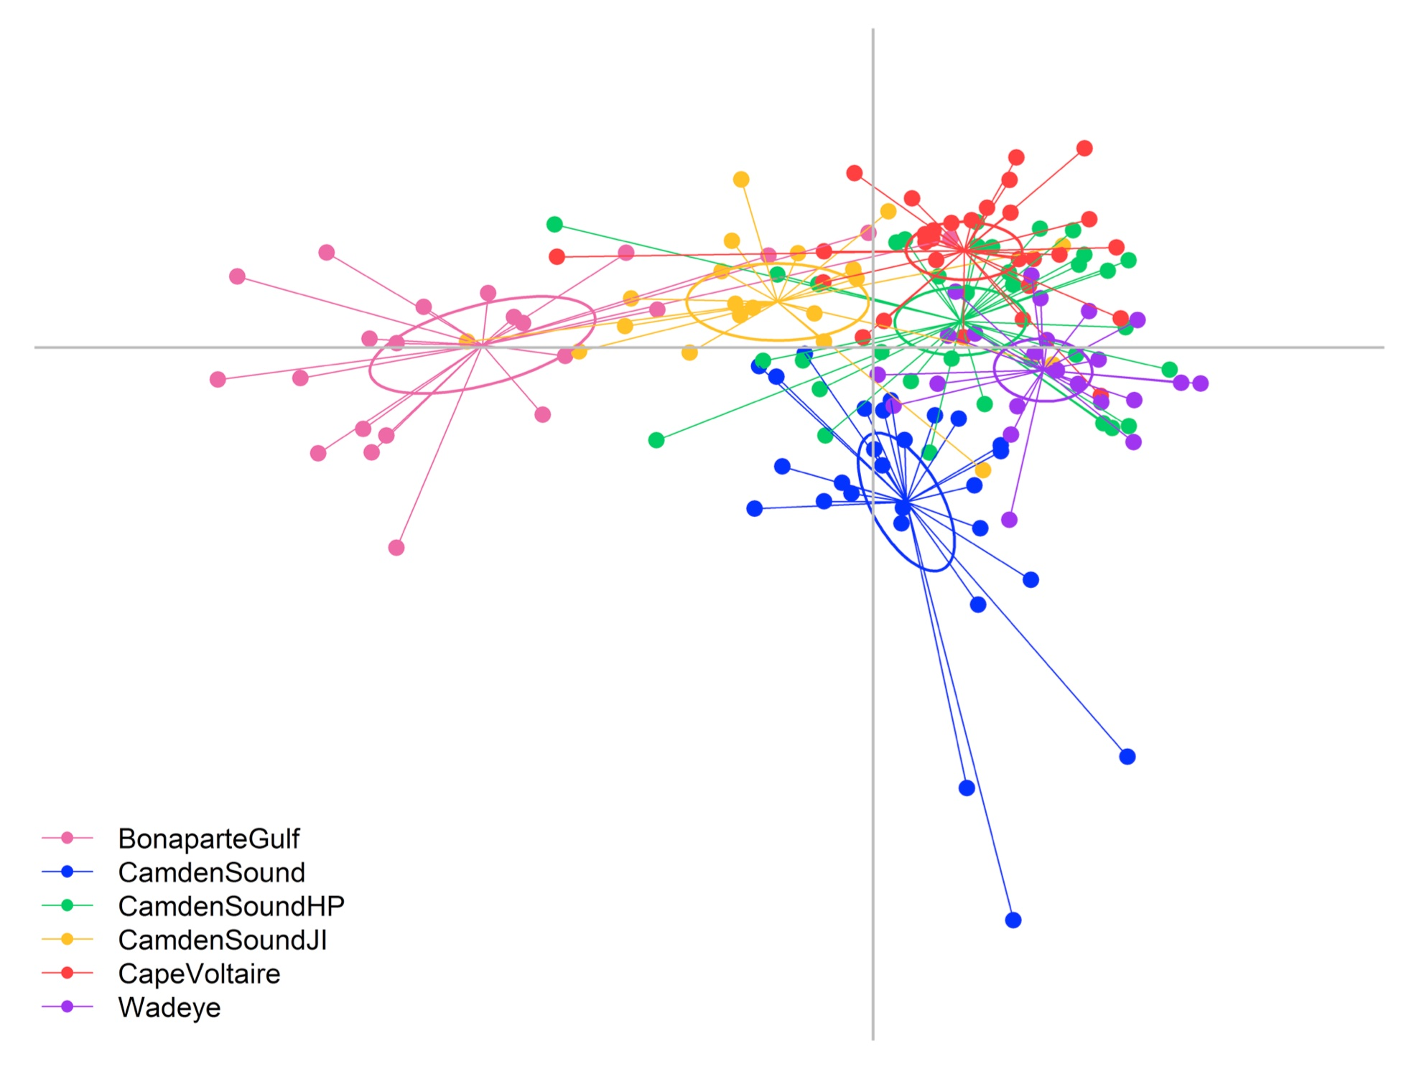
Otoliths – Method and Results
Otoliths record the environment of the fish
Because they grow around a nucleus, looking at different parts of the otolith informs the different stages of the fish life
11 trace elements (LA-ICPMS); 6 locations; 156 individuals
Otolith Near Core
LDFA
156 Ind. 6 Loc.
Otolith margin = adult stage
Nucleus
Otolith Margin
Otolith near core = juvenile stage
Near Core & Margin
Significant site separation (MANOVA and LDFA)
Site attachment across their life history
Dispersal also occurs by a proportion of juvenile or adult fish
LDFA
156 Ind. 6 Loc.
2-6 October 2017, Papeete

Slide 10
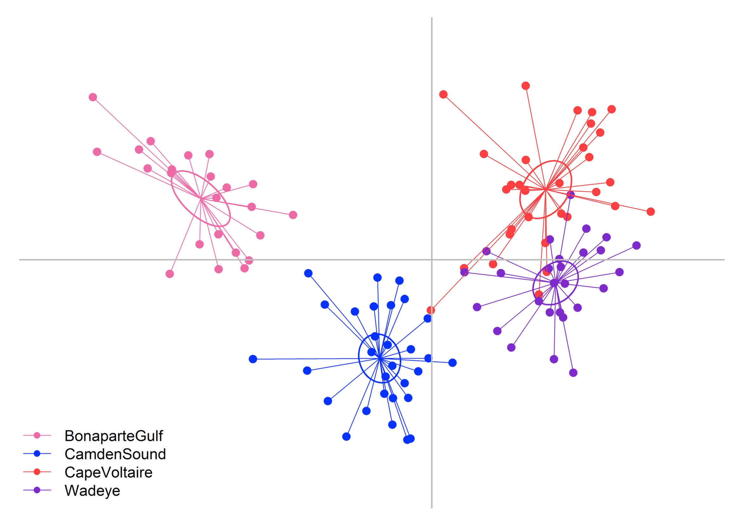
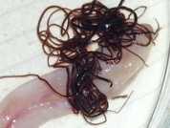
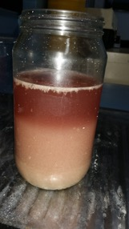
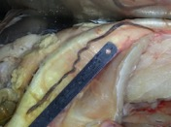
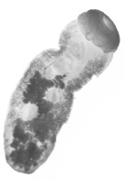
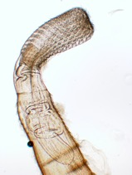
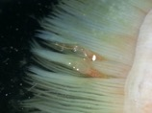
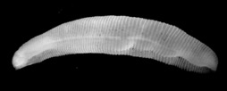
Parasites – Method and Results
Gills, mouth, intestinal system, mesenteries and ovaries
111 individuals; 4 locations
Direct life cycle: short-lived larval stages, unable to cover large distances, should reflect locality of origin
Indirect life cycle: travel through multiple hosts, have complex distribution pattern (numerous factors involved)
Combined the data because
Life cycles of aquatic parasites remain unknown
Provided more robust results
LDFA
111 Ind. 4 Loc.
Fish from different locations have distinct parasites’ fauna
2-6 October 2017, Papeete

Slide 11
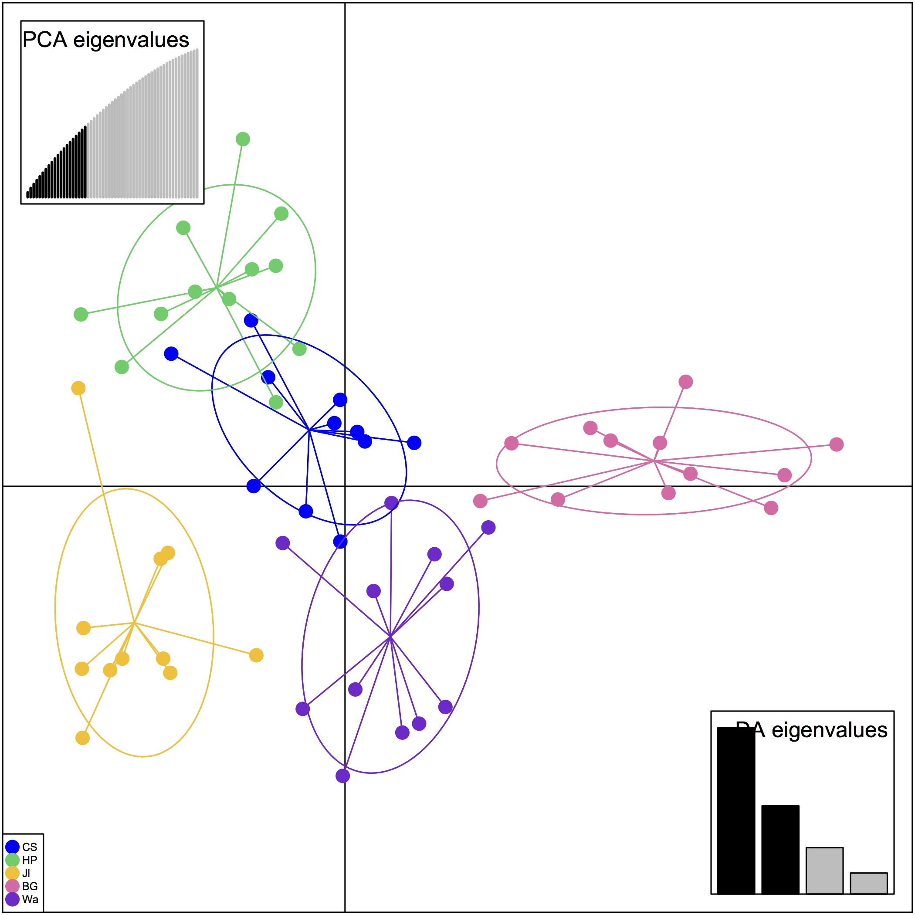
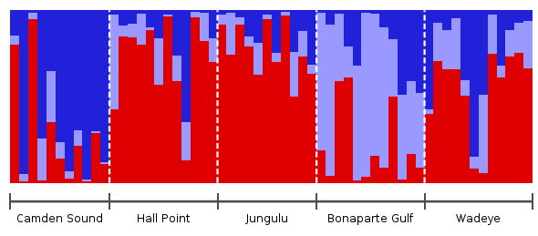
SNP - Method and Results
Outlier detection using Bayescan, Lositan and OutFlank
Used loci that are shared between the three techniques
217 loci potentially under selection
Hall Point
There is evidence of genetic structure at a small regional scale using outlier SNP
60 km appart
Camden Sound
Genetic structure operates at scale as small as 60 km
STRUCTURE confirms some genetic clustering between sites
60 km
appart
Bonaparte Gulf
Wadeye
Jungulu
2-6 October 2017, Papeete
Notes:
OutFlank = 0
Bayescan = 1
Lositan = 217

Slide 12
Local adaptation in the Kimberley region?
Otolith
Sites separation partly reflects different water chemistries
There is site attachment across the life cycle
Some dispersal occurs between locations
Parasites
Sites have different parasites compositions & abundances
Fish may have different physiological response to parasites between locations
Genomics
Genetic structure at scales as small as 60km
Maybe a signal of polygenic effect?
More work is required to link the habitat discontinuity, the fish response and the signal of local adaptation
2-6 October 2017, Papeete
Notes:
(large number of loci are favored in some environments)

Slide 13
Conclusions
Microsat vs SNP
Pattern of genetic ‘semi-structure’ across northern Australia (Kimberley, NT, Gulf of Carpentaria)
Structure at scales as small as 60km
Site attachment
Offshore vs inshore
Different physiological response to parasites between sites?
Importance of suitably designed genetic markers in association with ecological markers for stock discrimination
Local adaptation
SNP dataset provided an opportunity to investigate signatures of local adaptation
The combination of ecological markers and genetics sets a framework for a landscape genomic study
Small step further → otoliths measure the physiological effect of the habitat on the animal → parasite load is tightly linked to the fish fitness
2-6 October 2017, Papeete
Notes:
More statistical work is required to effectively link the pattern of local adaptation observed in the SNP data to the ecological markers

Slide 14
Acknowledgements
Collaborating scientists on the FRDC project: Mike Travers (WA Gov), Steve Newman (WA Gov), Jonathan Taylor (NT Gov), Mark Hearnden (NT Gov), David Welch (C₂O Fisheries), Richard Saunders (JCU), Christine Dudgeon (UQ).
Field assistance: staff from the Department of Fisheries (Government of Western Australia) and the Northern Territory Department of Primary Industries, Indigenous marine rangers from Borroloola, Maningrida, Wadeye, Larrakia and Dambimangari for the collection of specimens.
Lab work assistance: Safia Maher at the Molecular Fisheries Laboratory and Sean Corley at the Animal Genetics Laboratory for microsatellite genotyping.
Parasites identification: Frank Moravec, Geoff Boxshall, Ian Beveridge, Terry Miller, Jose Lluque, Jess Morgan, Delane Kritsky, Lesley Smales and Shokoofeh Shamsi.
Funding: Fisheries Research and Development Corporation (Project 2013/017), North Australia Marine Research Alliance (NAMRA—AIMS/ANU/CDU/NT Government) Postdoctoral Fellowship.
2-6 October 2017, Papeete

